Slide 1

Deploy ML Model on AWS Lambda with Dockery7hu6
This presentation outlines how to deploy a machine learning model on AWS Lambda using Docker. We'll cover everything from prerequisites to testing, ensuring a fast and scalable MLOps solution.
HF
by Humaila Farooq

Slide 2
Deployment Overview
Key Steps
Prerequisites
Build Docker image for news prediction model.
AWS account with permissions.
Push image to Amazon Elastic Container Registry (ECR).
AWS CLI installed.
Docker Desktop installed.
Create AWS Lambda function.

Slide 3




Prerequisites Installation
AWS Account
Access the AWS console for necessary permissions and services.
AWS CLI
Install the Command Line Interface for AWS service management.
Docker Desktop
Download and install Docker for containerization capabilities.

Slide 4
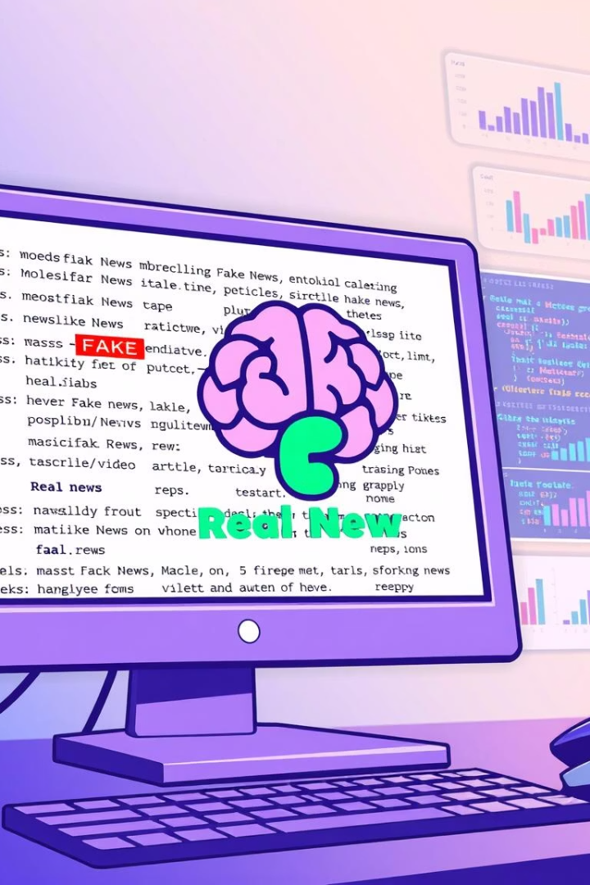




Model Training Process
Load Data
Use Python (train.py) to load fake and real news datasets.
Process Text
Combine titles and content for text data preparation.
Train Model
Train a Linear Support Vector Classifier using scikit-learn.
Save Assets
Save the model (news_model.pkl) and TF-IDF vectorizer (tfidf_vectorizer.pkl).

Slide 5
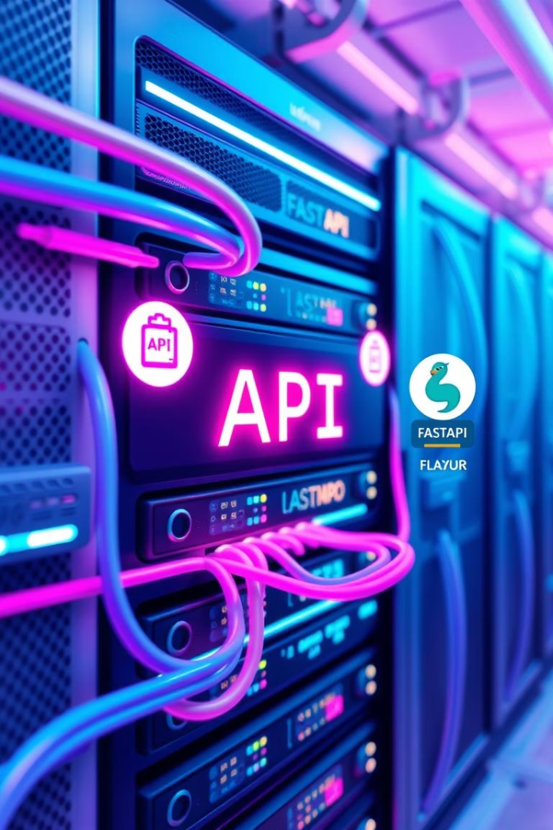
Model Serving with FastAPI
FastAPI Integration
Docker Image Creation
Prepare the trained news prediction model using FastAPI or Flask.
Include app.py, Dockerfile, and requirements.txt for the image.
API Response
Receive JSON responses indicating "Fake" or "Real" news predictions.

Slide 6
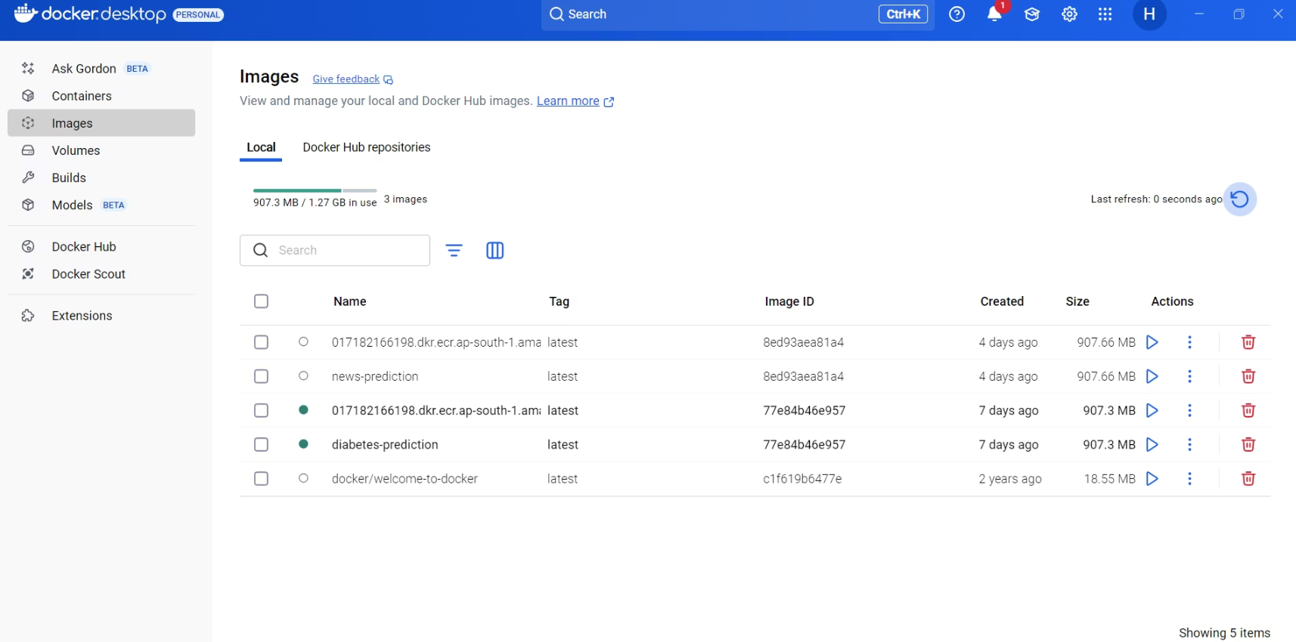

Slide 7
Docker Configuration
Base Image
1
Use a public AWS Lambda-compatible Python 3.10 base image.
Copy Files
2
Copy model, vectorizer, requirements.txt, and app.py to image.
Install Libraries
3
Install specified libraries in the Lambda task root directory.
Verify Setup
4
Ensure AWS CLI is configured and Docker Desktop is running.

Slide 8
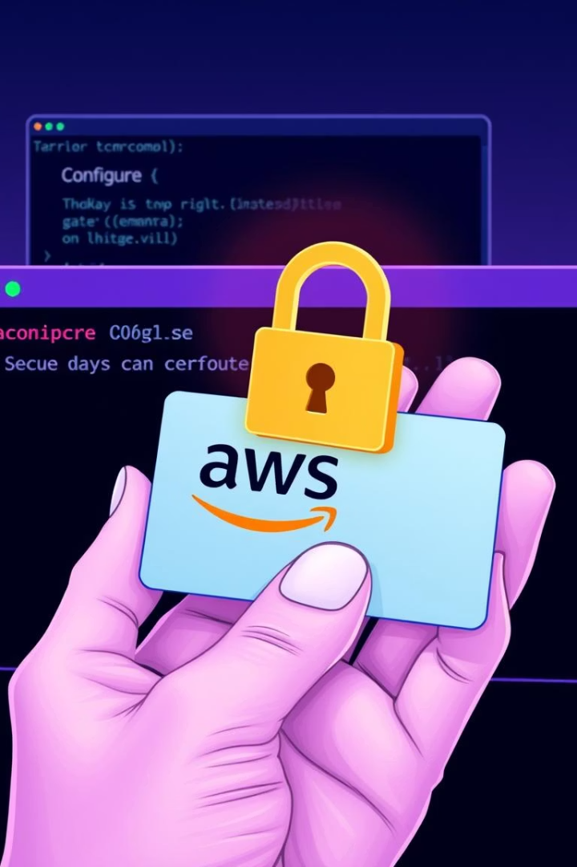
AWS CLI Configuration
1
Generate Keys
Create AWS access keys via the security credentials section.
2
Save Secret Key
Securely save the generated secret access key.
3
Configure CLI
Use 'aws configure' to set up access key ID, secret, region, and format.

Slide 9




ECR Repository Setup
Create Repository
Login
Name the repository 'news-prediction' for Docker image storage.
1
2
Execute command-line instructions to log into ECR.
Push to ECR
4
Build Image
Push the Docker image to your Amazon ECR repository.
3
Build the local Docker image for deployment.

Slide 10
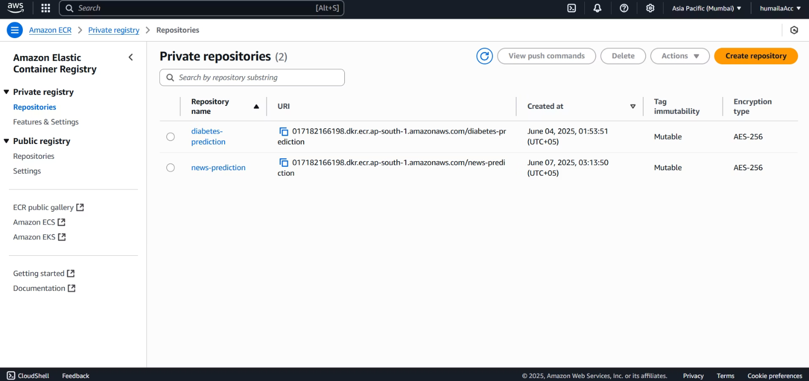
ECR

Slide 11
Lambda Function Creation
Access Lambda Console
Navigate to the AWS Lambda service in the console.
Create Function
Choose to create a function from a container image.
Configure Settings
Adjust memory, timeout, and permissions for the function.
Set Function URL
Create a secure function URL for API testing.
Test and Deploy
Verify API Gateway settings and test the deployed model.

Slide 12
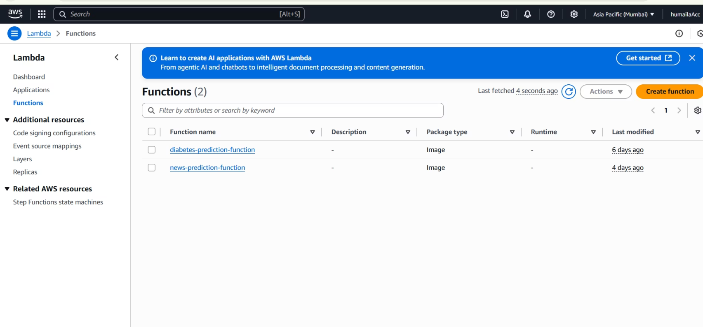

Slide 13
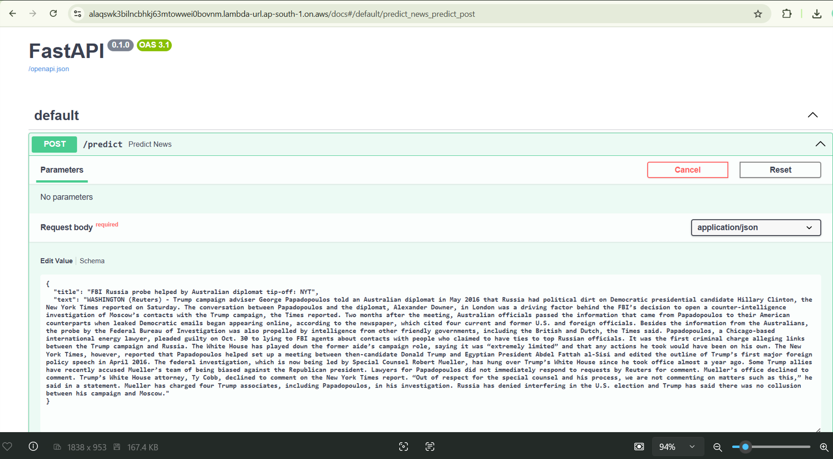

Slide 14
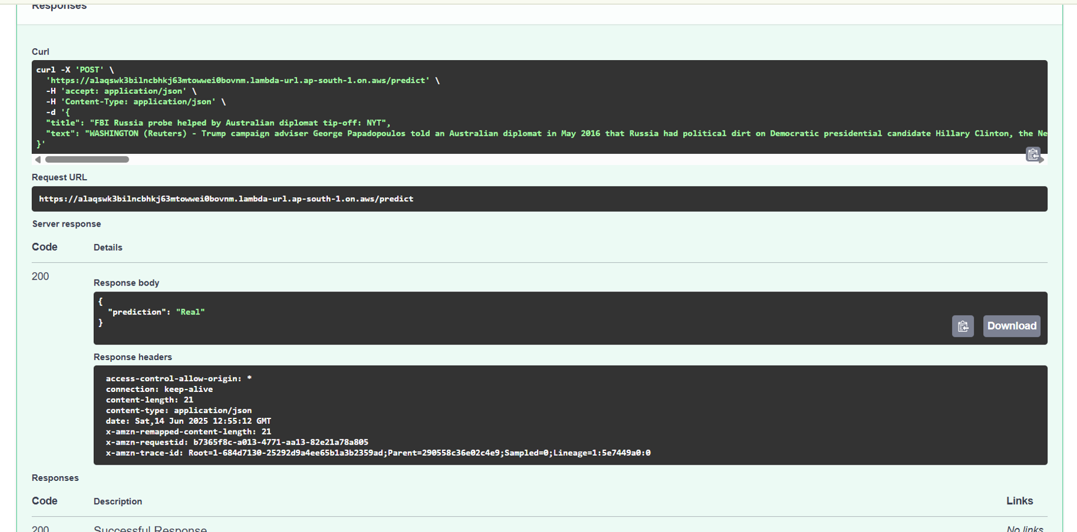

Slide 15
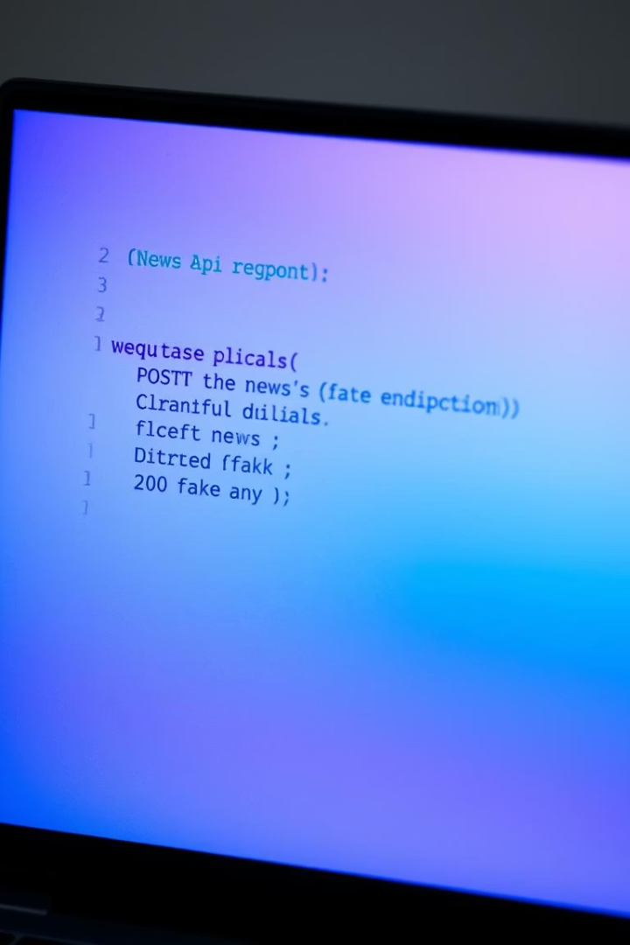
API Testing and Invocation
200
Success Code
A 200 response indicates a successful API call.
1
Prediction
The model predicts either "Fake" or "Real" news.
Install the 'requests' library to invoke the API. Make a POST request with sample news data. Adjustments can be made to the training script for better prediction.

Slide 16
